Slide 1
Minor Project
by
Dhruvil Rana & Jatin

Slide 2
Project Overview
Placement Portal for Nirma University (JPNU)
A platform to manage campus recruitment activities.
Role-based access for students, companies, coordinators, and admins.
Students manage profiles, track applications, and generate resumes.
Companies post job openings, view applications, and manage schedules.
Automated eligibility checks for job applications.
Centralized announcements and email notifications.

Slide 3
Key Features
Secure Login : Role-based access control for all users.
Job Posting : Companies post jobs, and students apply.
Profile Management : Students maintain academic details and resumes.
Application Tracking : Real-time status updates on job applications.
Company Visit Schedules : View and manage interview schedules.
Automated Email Reminders : Alerts for deadlines and events.
Expenditure Management : Manage all the expenditures of company visit on campus

Slide 4



Frontend
Technology used

Slide 5


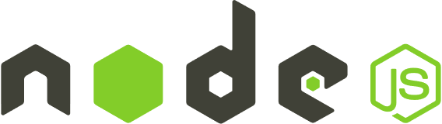
Backend
Technology used

Slide 6
Why MERN Stack?
MongoDB : Flexible and scalable NoSQL database.
Express.js : Simplified backend API development.
React.js : Dynamic and responsive user interface.
Node.js : Fast and scalable backend runtime.
Full-Stack JavaScript : Streamlined development process.
Real-Time Updates : Ensures users work with the latest information.

Slide 7

Progress done

Slide 8
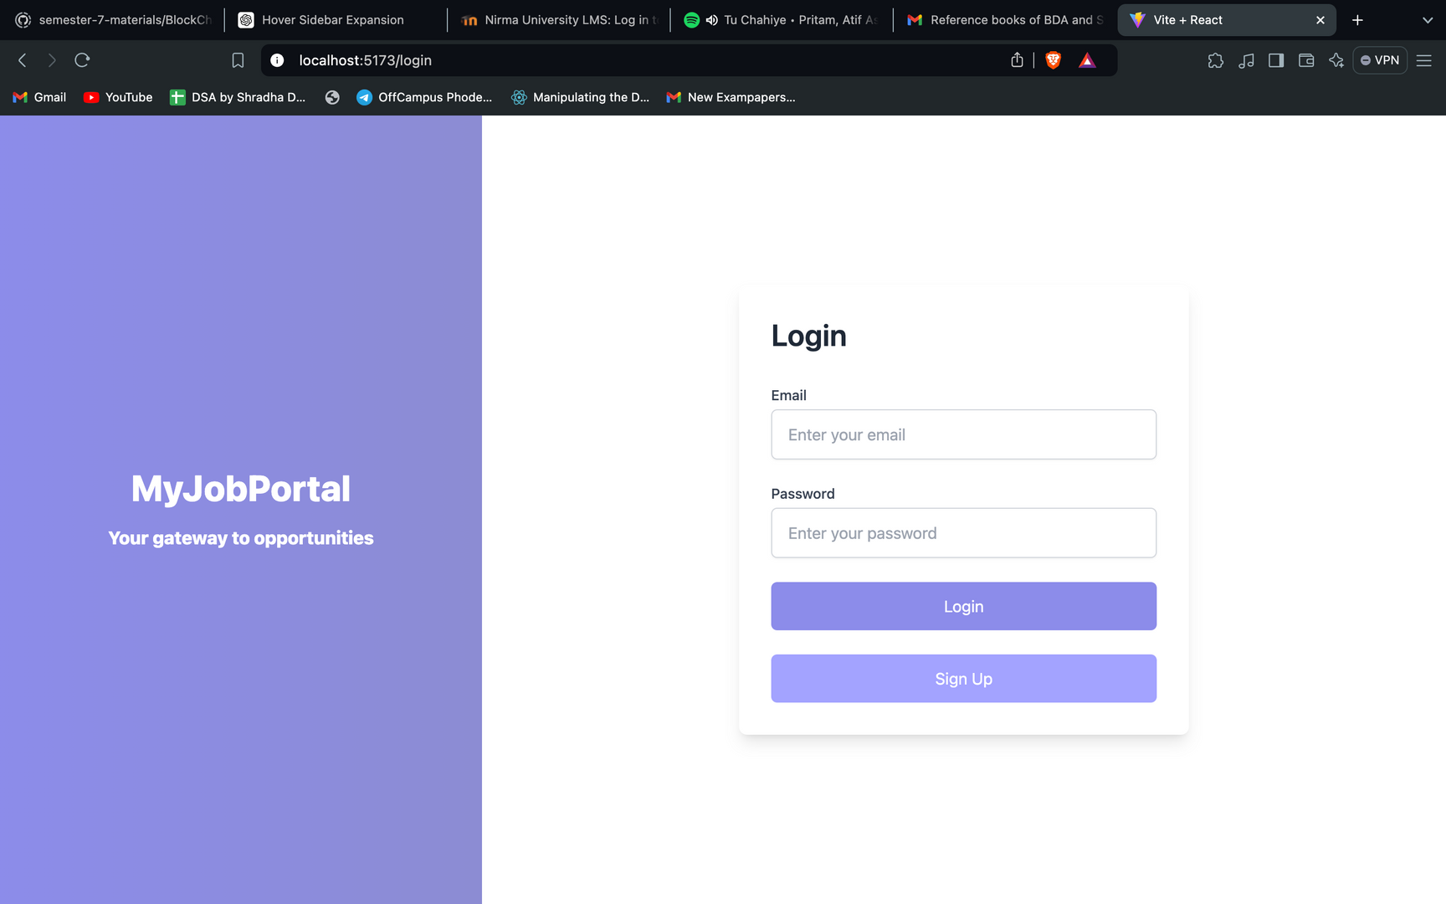

Slide 9
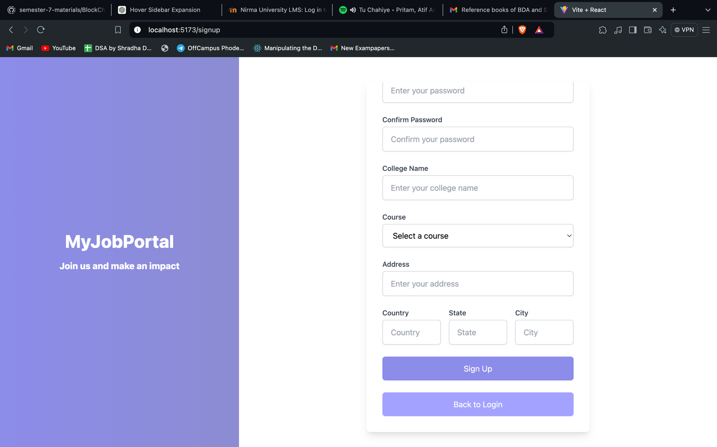

Slide 10
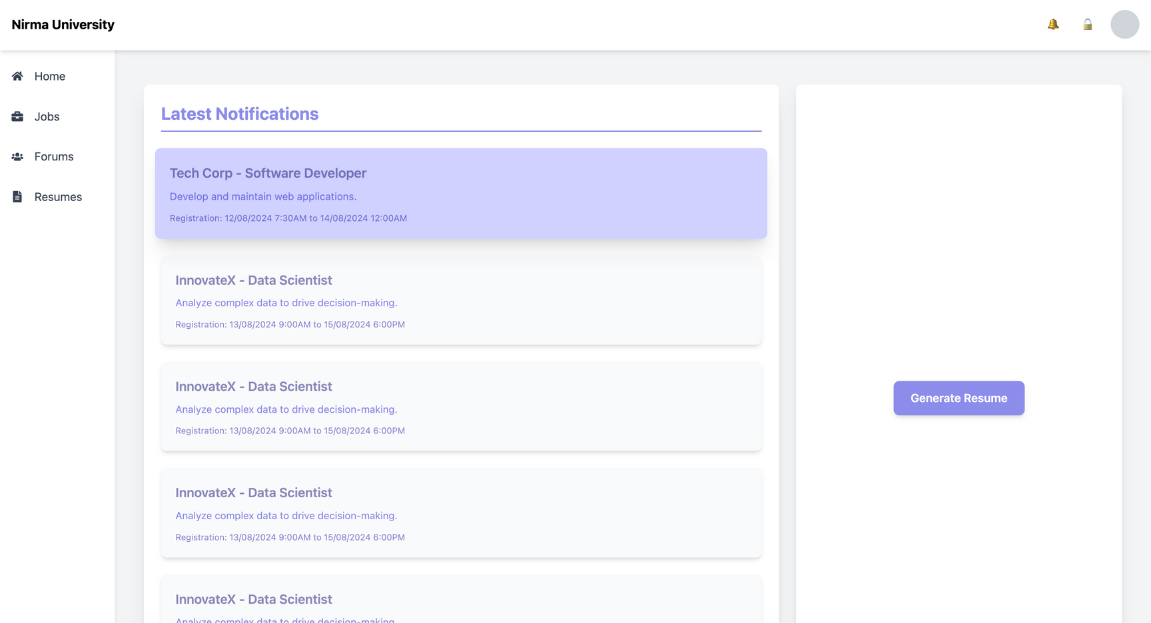

Slide 11
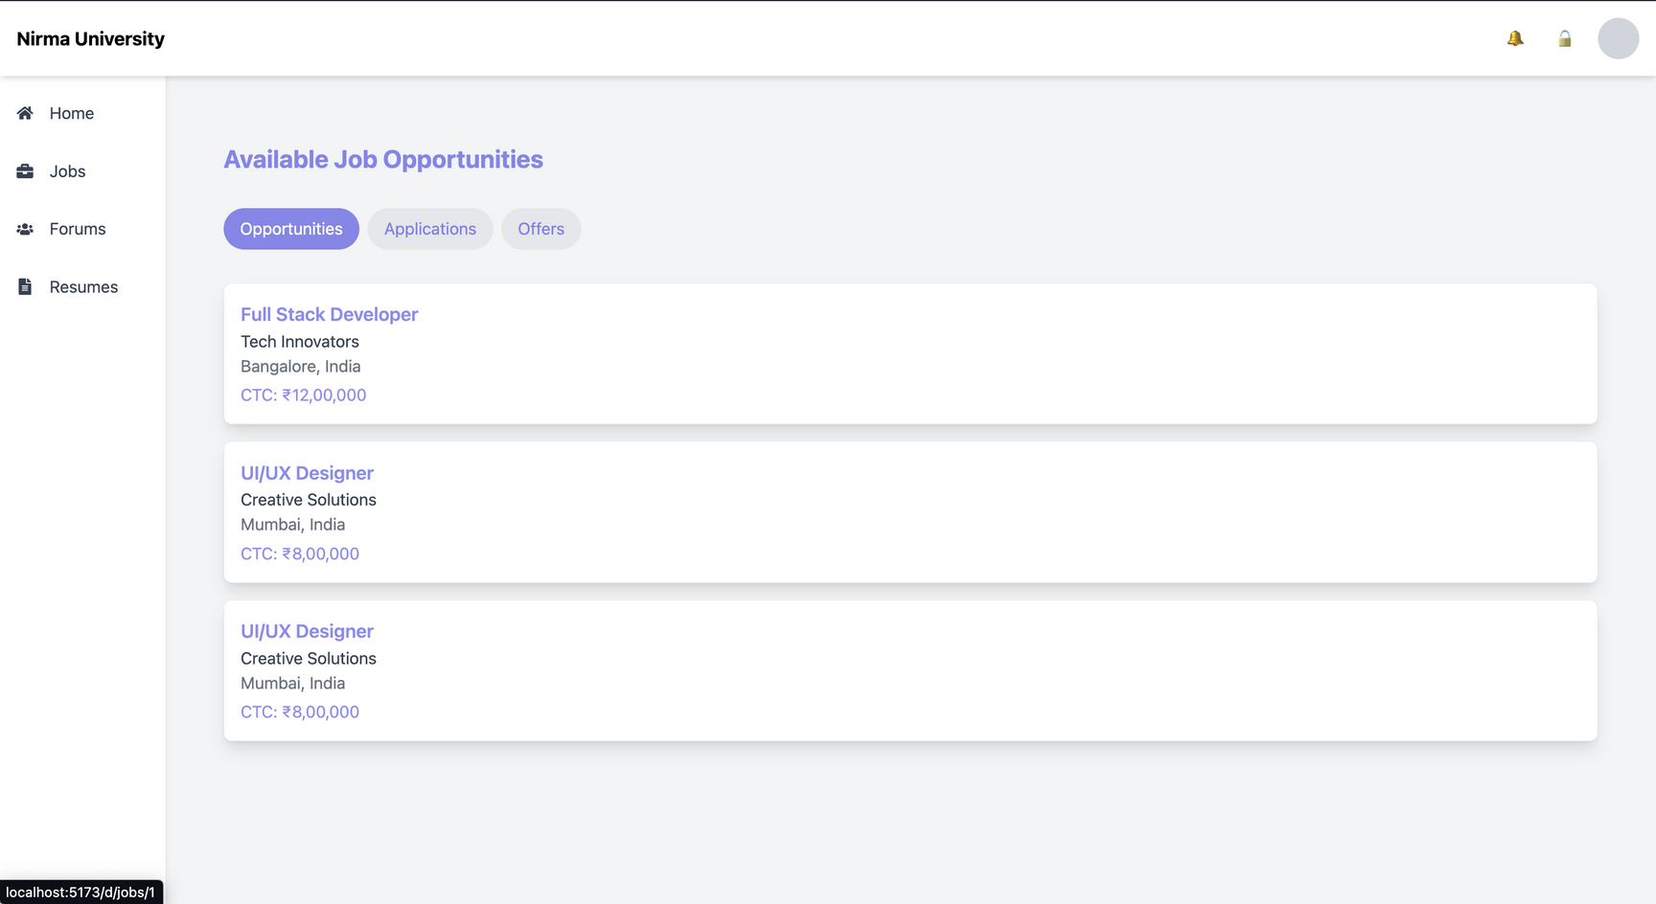

Slide 12
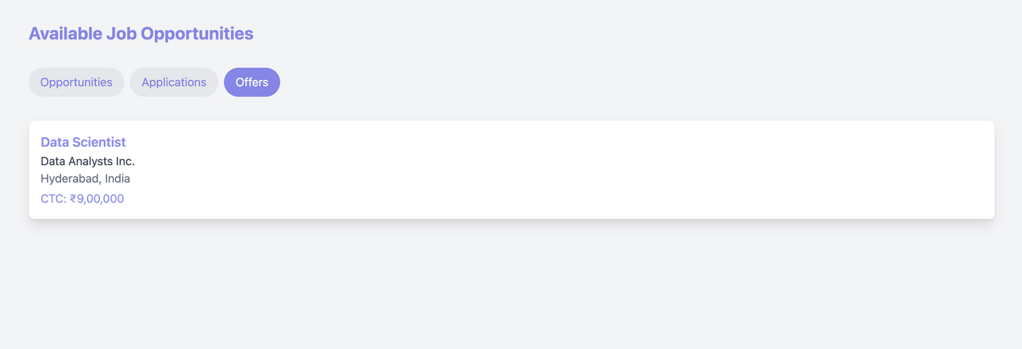
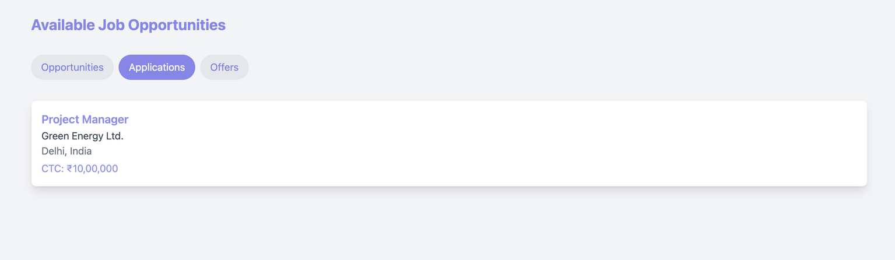

Slide 13
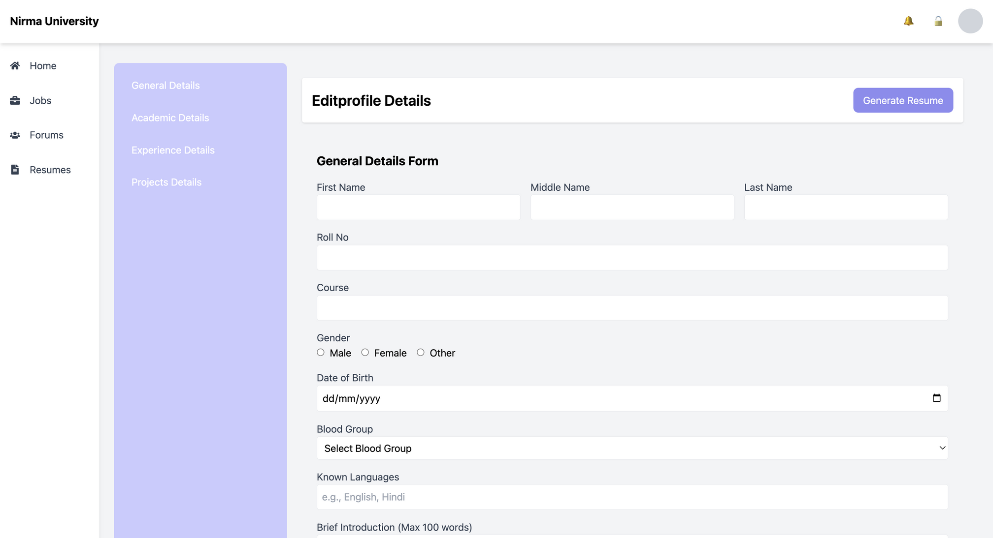

Slide 14
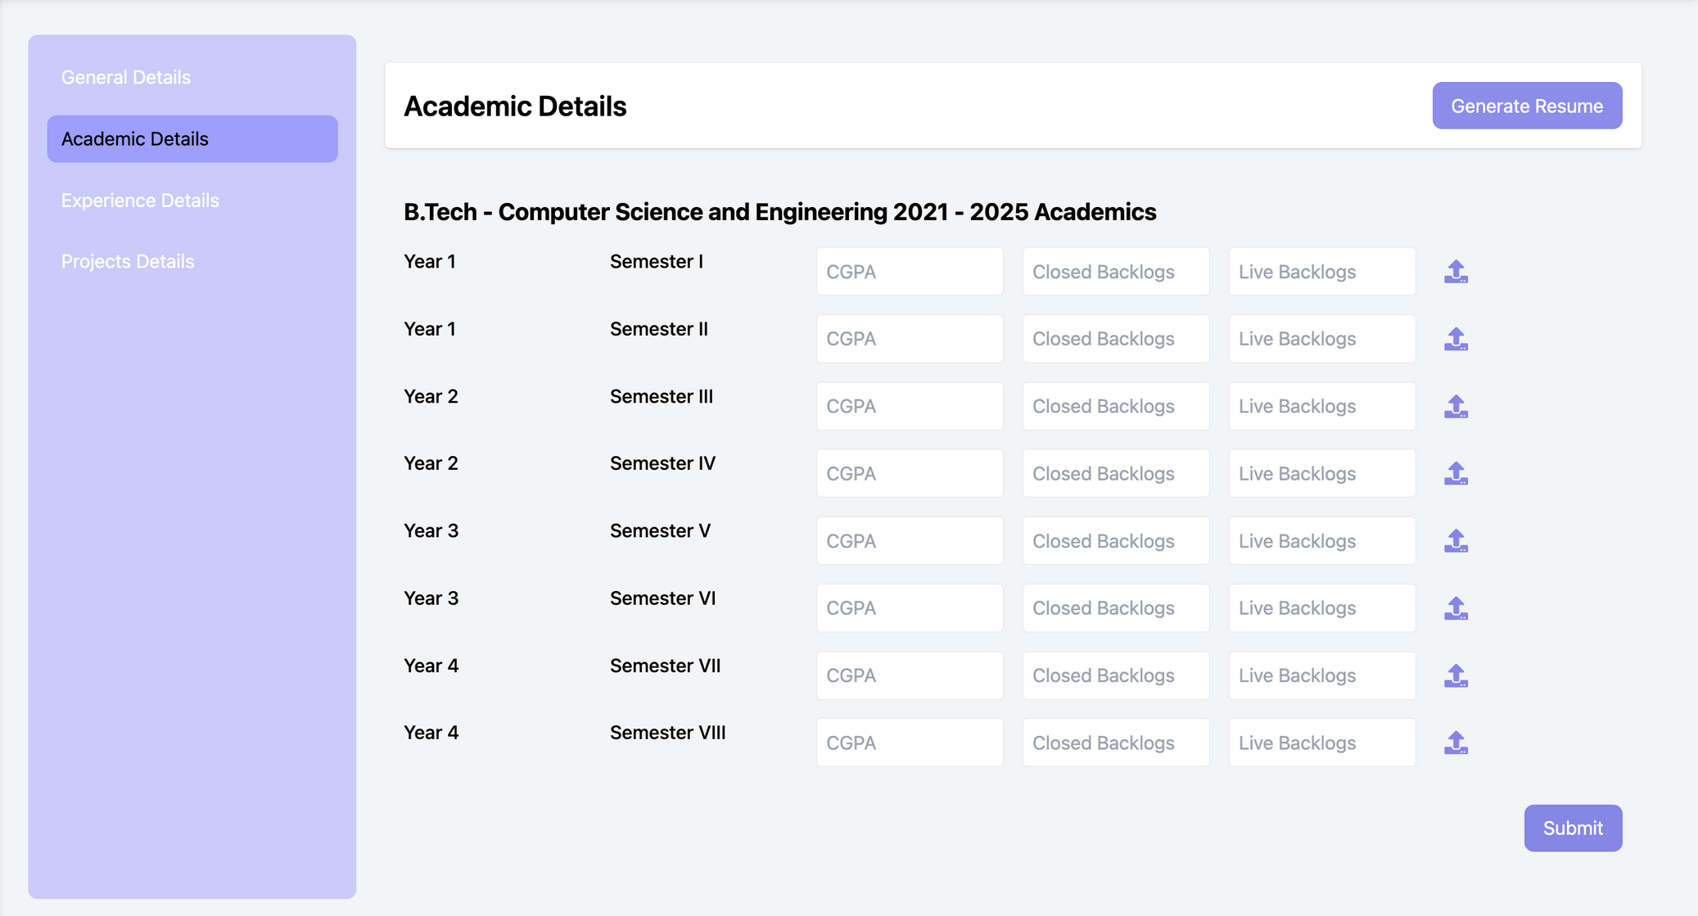

Slide 15
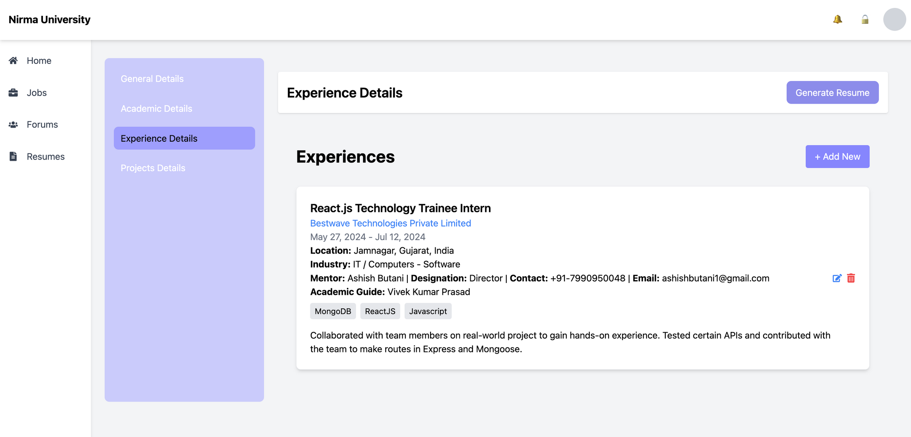

Slide 16
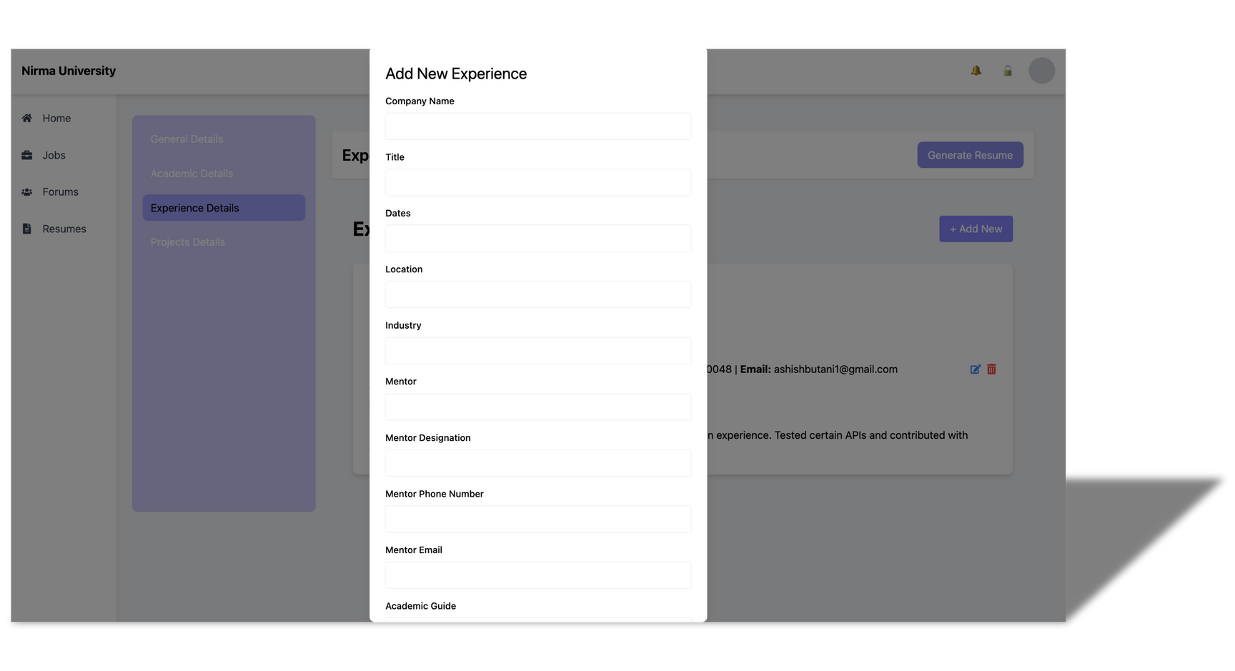
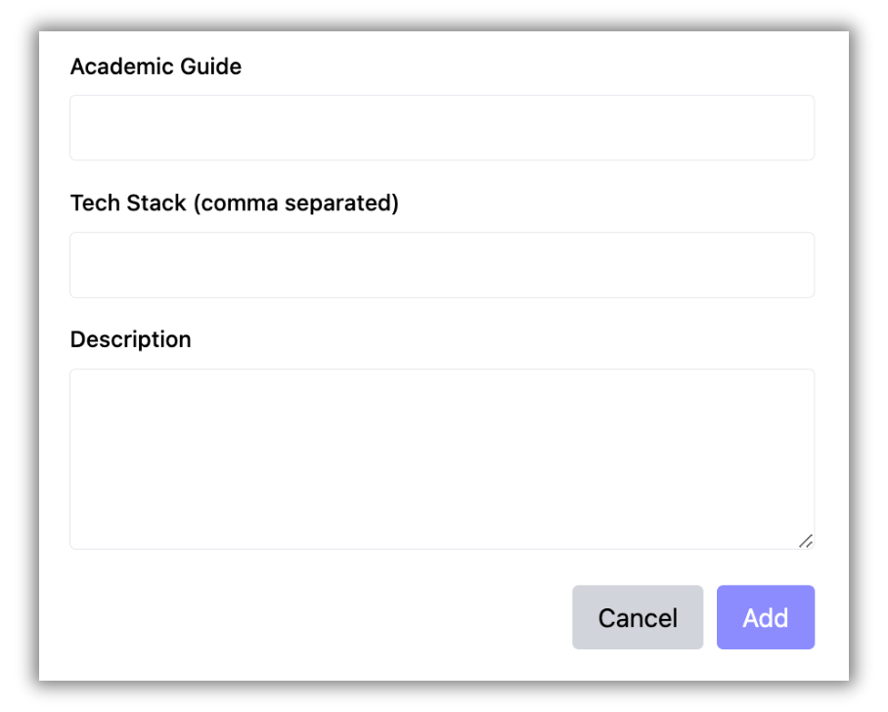

Slide 17
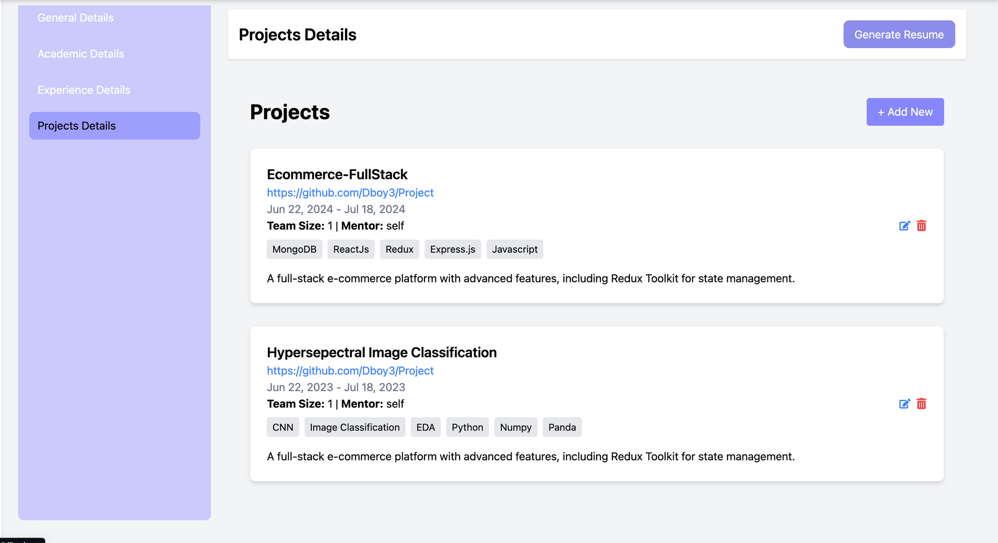

Slide 18
